Slide 1
‘On the Sidewalk….’
Lesson Objective(s)
To make predictions from part of a title and from dominant images.
Do Now:
Make notes of your predictions (guesses) about what you would expect to read in the text ‘On the Sidewalk …’ which includes these images:

Slide 2
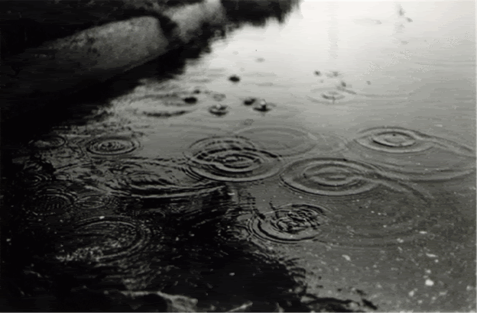
‘On the Sidewalk….’

Slide 3
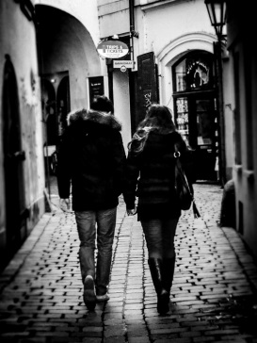
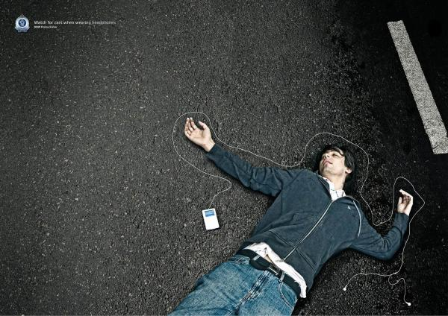
‘On the Sidewalk….’

Slide 4
‘On the Sidewalk….’

Slide 5
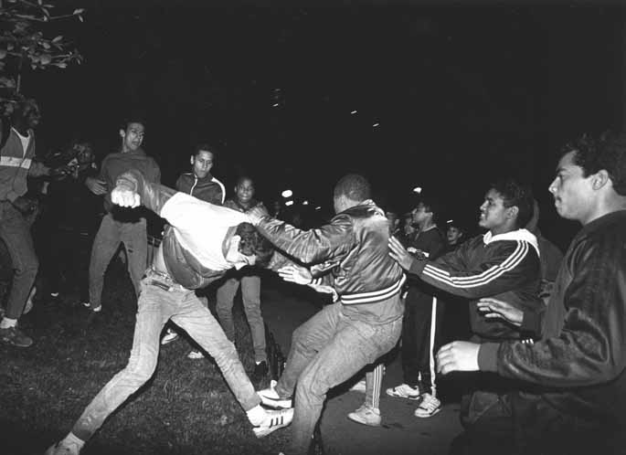
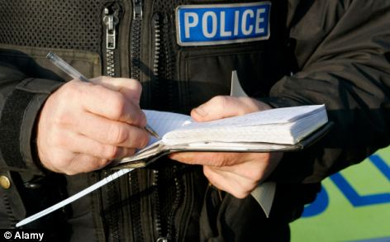
‘On the Sidewalk….’

Slide 6
‘On the Sidewalk _____’
I think the story is about…. I say this because the image of the…could support this prediction. Another image that would support this idea is… In this image you can clearly see…All these images is linked to the idea of….
I can associate with these images because in my life…. I think the message the author is trying to convey is that… He is trying to warn…I would use the word….to complete the title.

