Slide 1
I, like you understand this. We must ensure our voice is heard.
Personal
Pronouns.
Creates a connection with the reader

Slide 2
Personal
Pronouns.
Create an ‘us’ and ‘them’ separation
They may control us by
spreading their message of fear.

Slide 3
Tone.
Is the writing serious:
humorous
friendly
dramatic
sensational
or moral (warning)
This is directly linked to the purpose (to inform, persuade, entertain) of the text. Try and imagine how the writer’s voice would sound if they read their text aloud. This should give you a good idea of the tone of the text, as tone of voice and tone of writing are very similar.

Slide 4
Quotation.
If the author directly quotes an expert’s opinion:
- adds weight to their argument
- makes their writing appear more convincing.
Doctor Albertson said, “There is a direct link between childhood sunburn and skin cancer.”

Slide 5
Irony…
…using language in a way that means just the opposite, typically for humorous effect.
A man is hit by a vehicle and needs to be rushed to hospital. The vehicle that hits him is an ambulance…

Slide 6
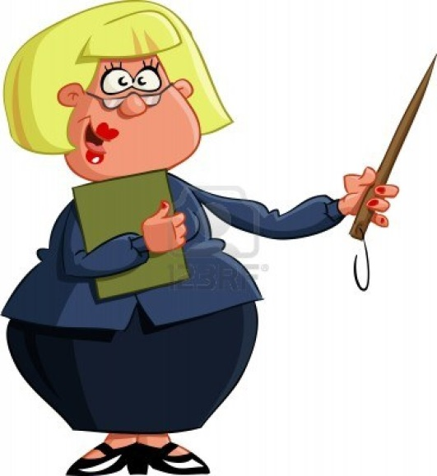
Sarcasm.
Making fun of someone,
often disguised as praise
(though sarcasm may be funny, it may also hurt many people)
Not the brightest crayon in the box now, are we?

Slide 7
Pun.
A play on words giving humourous
double meanings
Hair today, gone tomorrow!

Slide 8
Emotive Language.
Positive emotional responses
This impressive plan presents an
elegant and visionary solution.

Slide 9
Emotive Language.
Negative emotional responses
This ridiculous plan demonstrates a
naive and fanatical idea.

Slide 10
Rhetorical Question.
A question, asked for effect,
that does not require an answer.
Why me?

Slide 11
Imperative.
A direct request
or command
Call now!

Slide 12
Hyperbole.
An exaggeration used for effect.
We have heard it a million times...

Slide 13
Repetition.
Deliberately repeating words,
within or between sentences, for effect.
It was scary, very, very scary.

Slide 14
Parallel Structure.
Repeating phrases of similar structure
within or between sentences.
More jobs, more wealth,
more opportunities.

Slide 15
Statistics.
Statistics emphasise a point
20% of the world’s population
consume 80% of the world’s resources.

Slide 16
Listing.
Writing a list in order to emphasise a point.
This will affect the rich and the poor, the young and the old, those with jobs and those without.

Slide 17
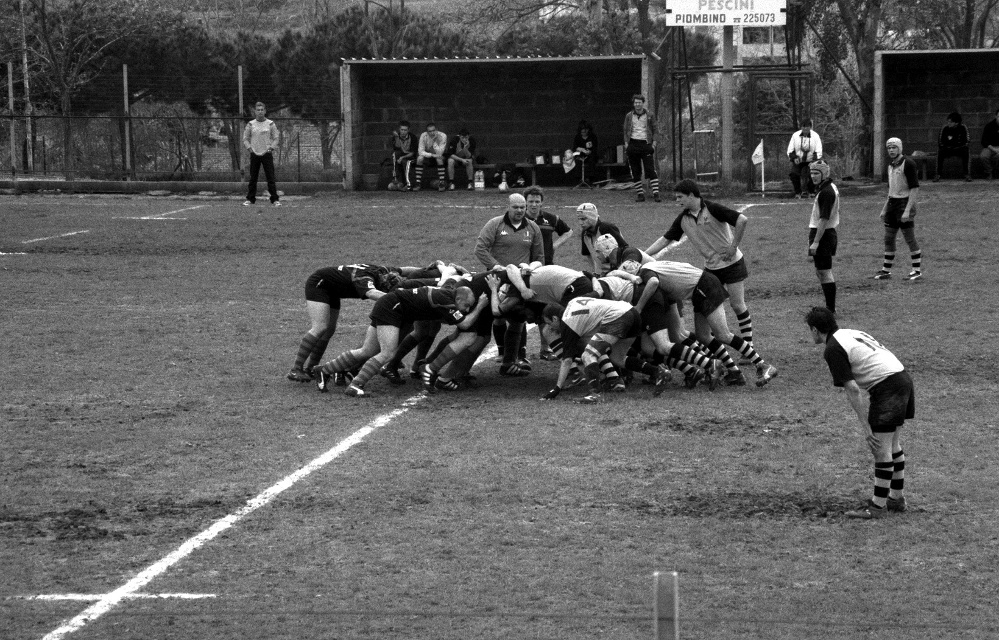
Anecdote.
Brief account of an interesting
or amusing real life incident
The name “All Blacks” goes back to 1905 when...

Slide 18
Cliché.
Over-used phrases
The grass is always greener
on the other side...

Slide 19
Euphemism.
A polite phrase that is
less offensive than another.
Using ‘he passed away’
rather than ‘he died’

Slide 20
Superlatives.
Adjectives that indicate the
highest degree of some quality
Tallest
Fastest
Most Beautiful
Greatest
Finest

Slide 21
Narrative Point of View.

Slide 22
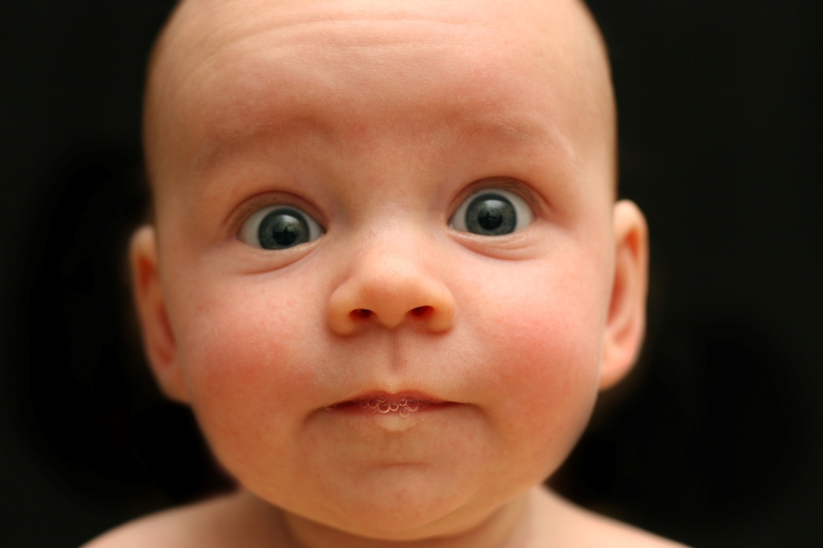
First Person.
When one character tells the story.
I walked...
I cried...
I decided...

Slide 23
Third Person.
Narrator is NOT a character
Uses “he”, “she”...
Sarah walked...
She decided...

Slide 24
Eye of God.
All seeing, all knowing narrator
Knows all the thoughts of all the characters

Slide 25
The End.

