Slide 1
Foreshadowing
An introduction early in the movie of something that is going to happen in the text, a clue…

Slide 2
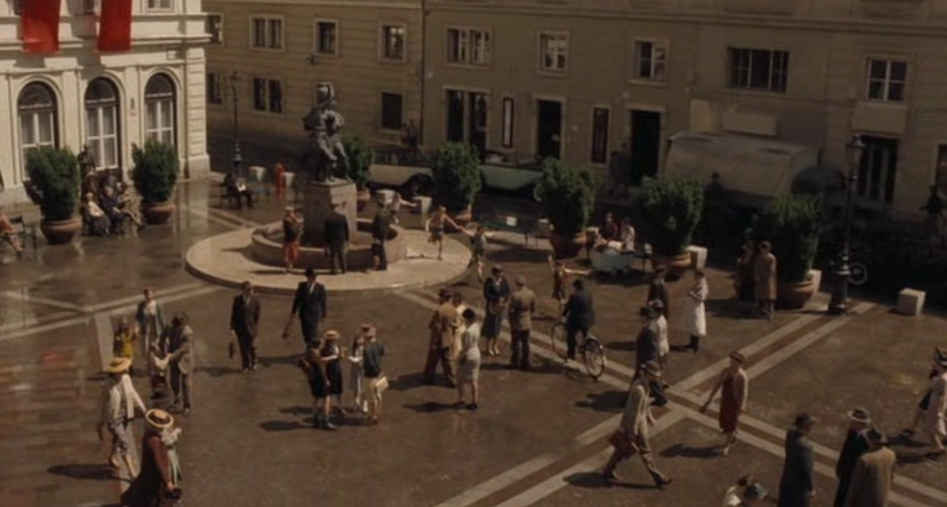
1.Foreshadowing the start/end

Slide 3
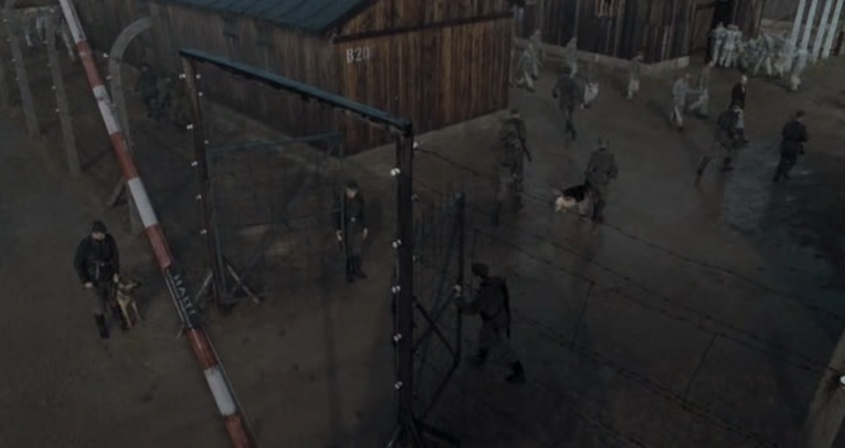

Slide 4
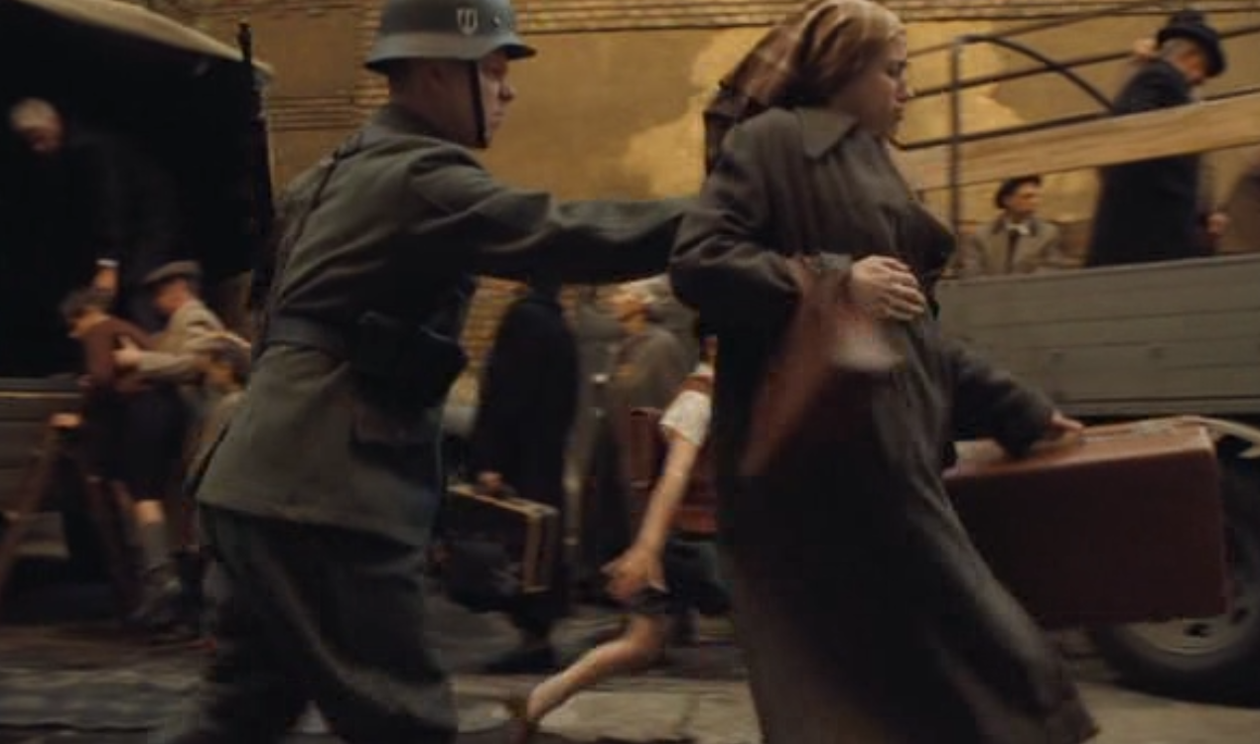
2.Foreshadowing

Slide 5
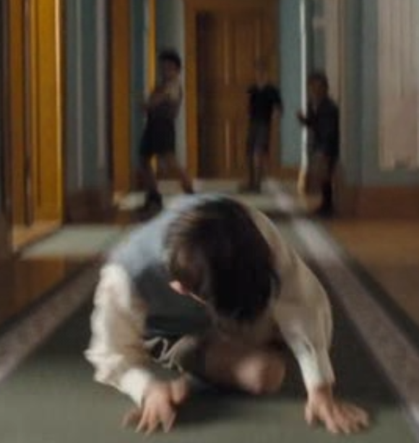
3.Foreshadowing

Slide 6
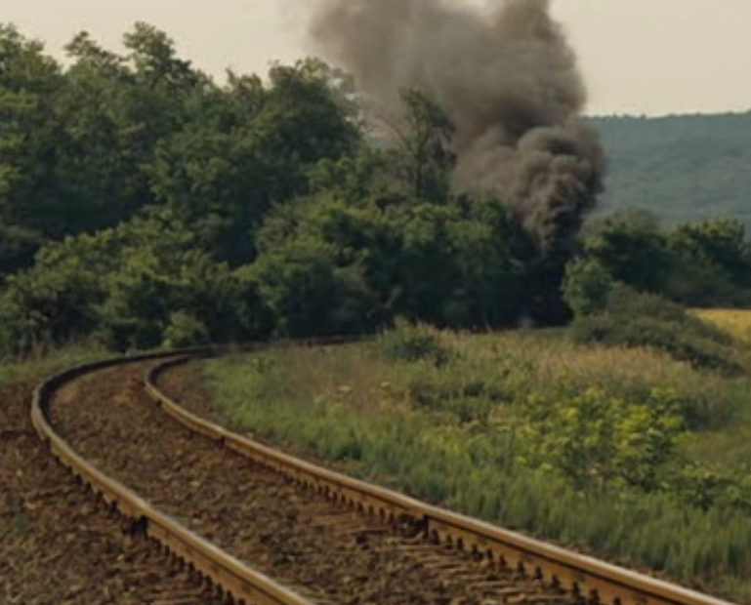
4.Foreshadowing

Slide 7
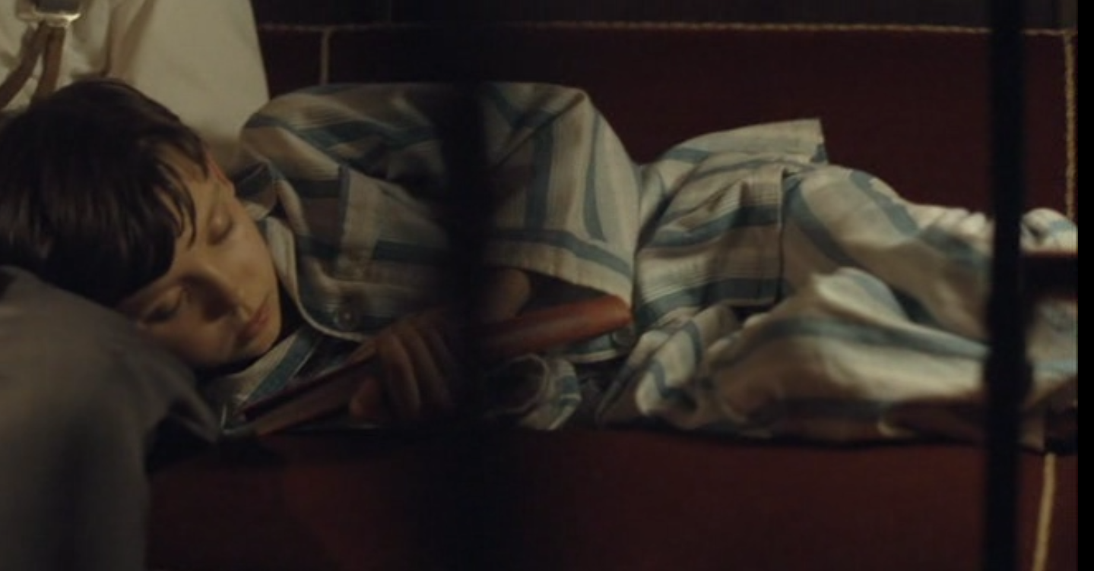
5.Foreshadowing

Slide 8
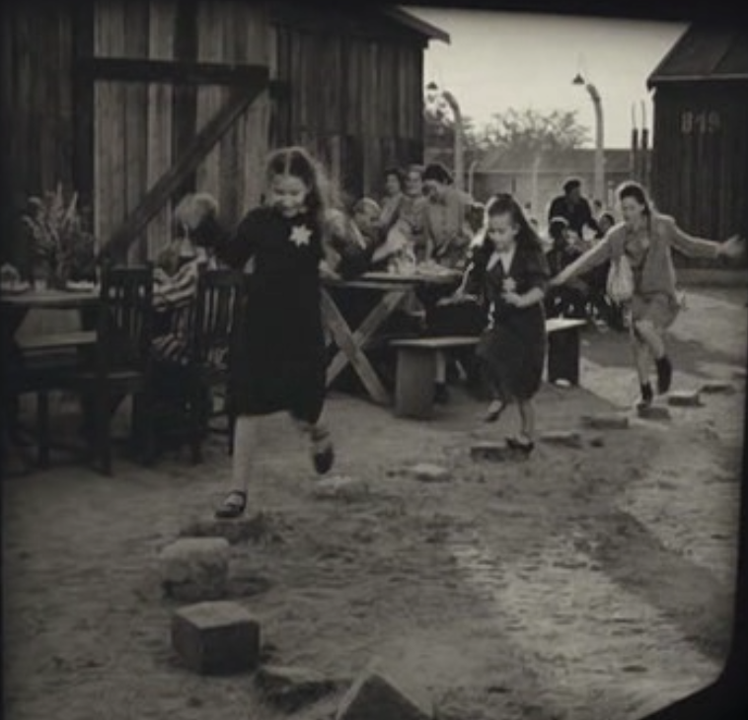
6.Foreshadowing

Slide 9
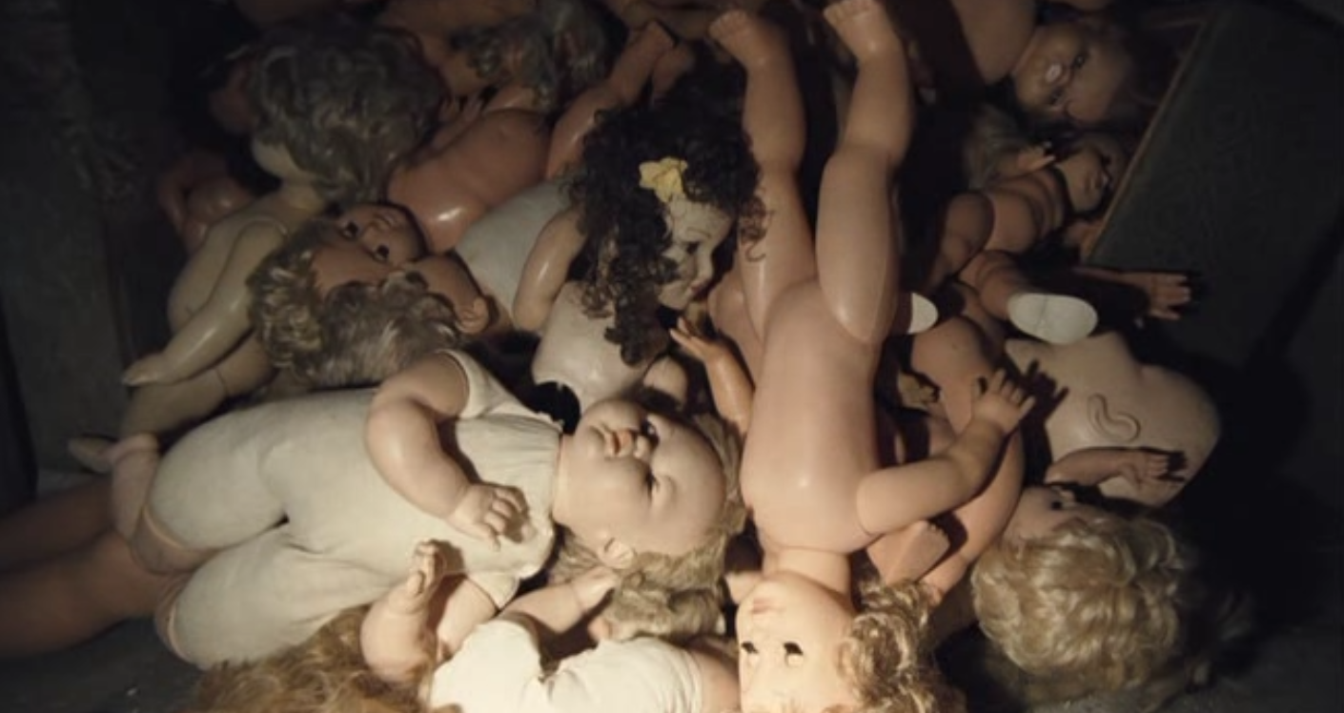
7.Foreshadowing

Slide 10
Symbolism
The use of one object or action to represent or suggest something else.

Slide 11
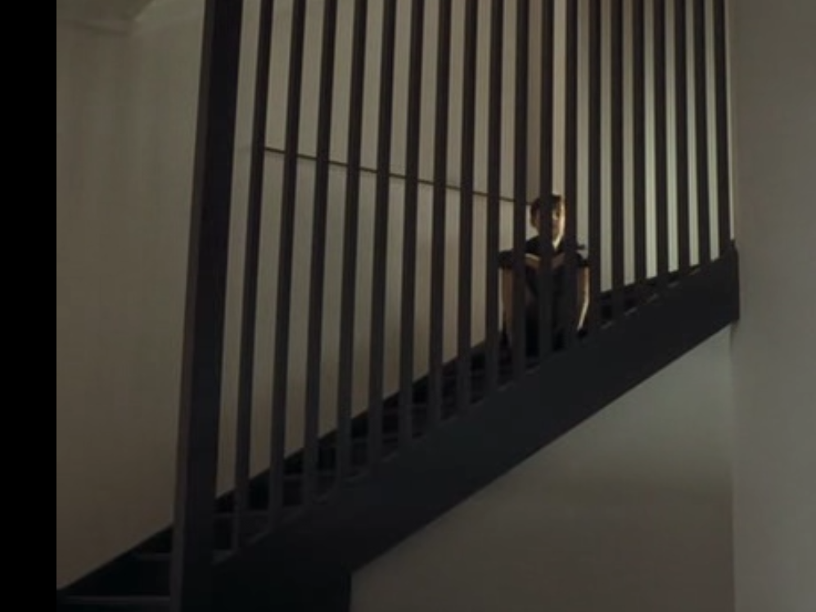
8.Symbolism

Slide 12
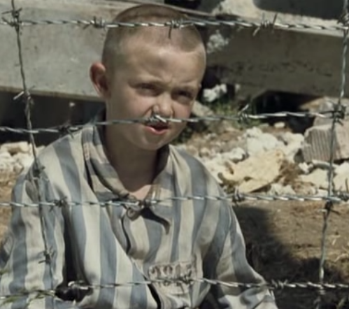
9.Symbolism

Slide 13
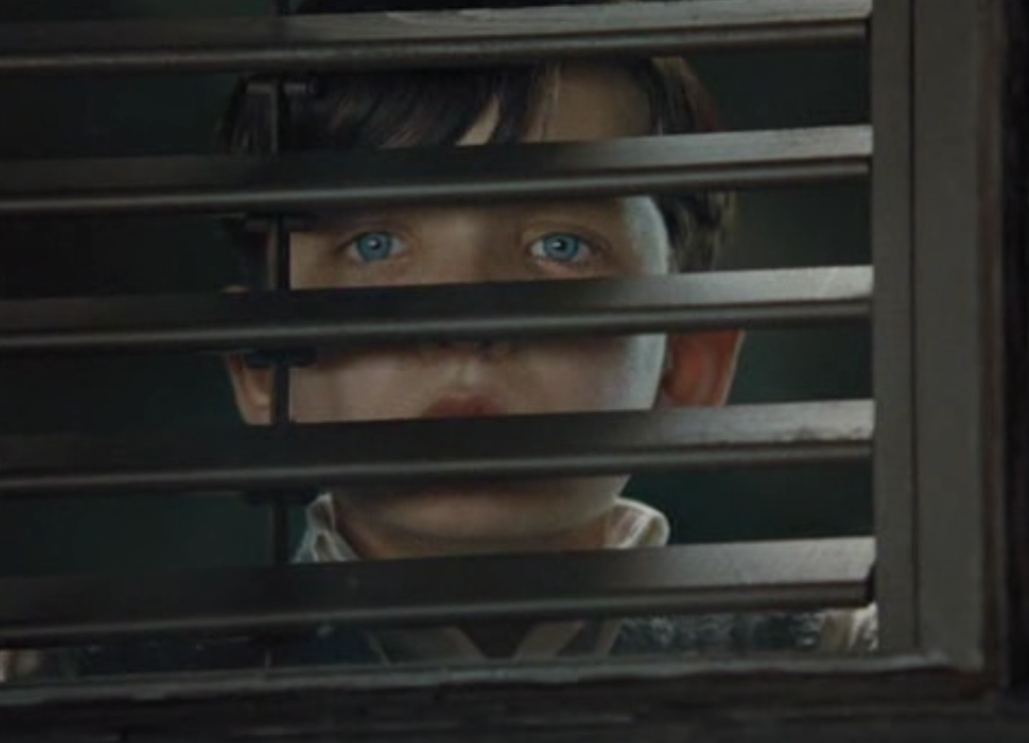
10.Symbolism

Slide 14
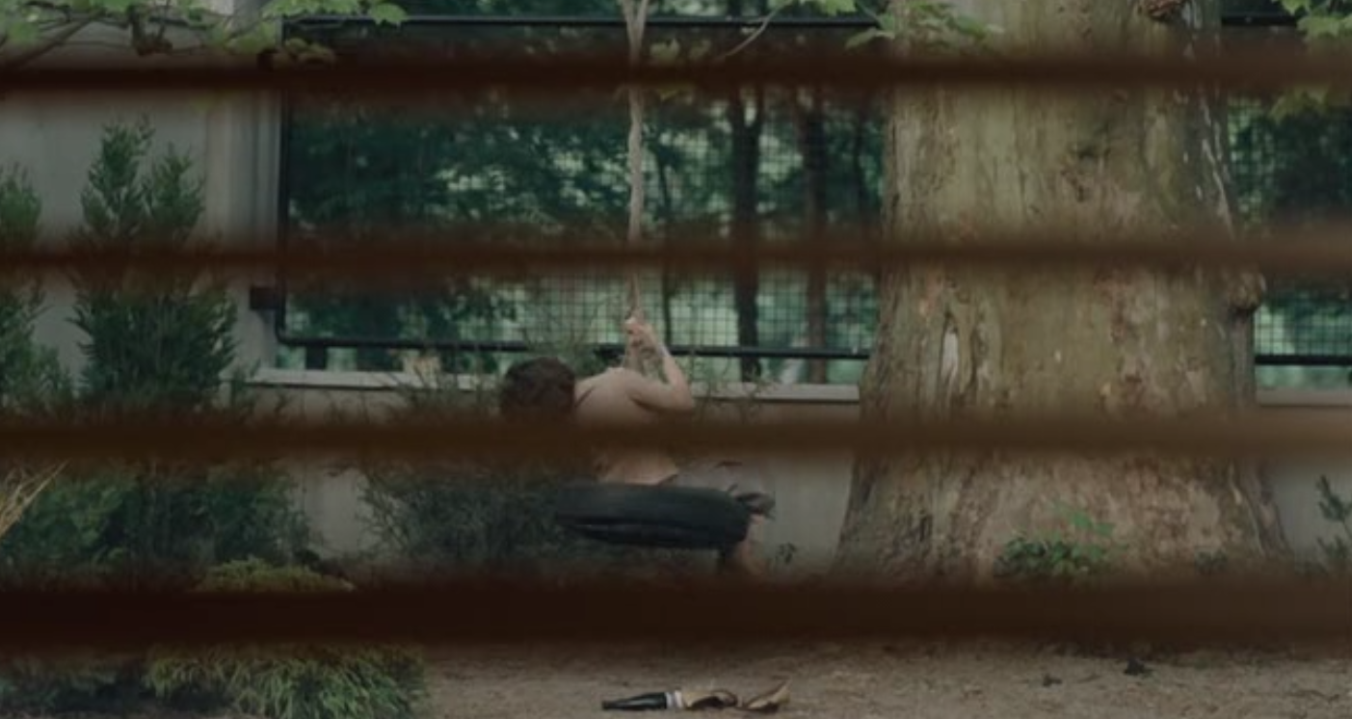
11.Symbolism

Slide 15
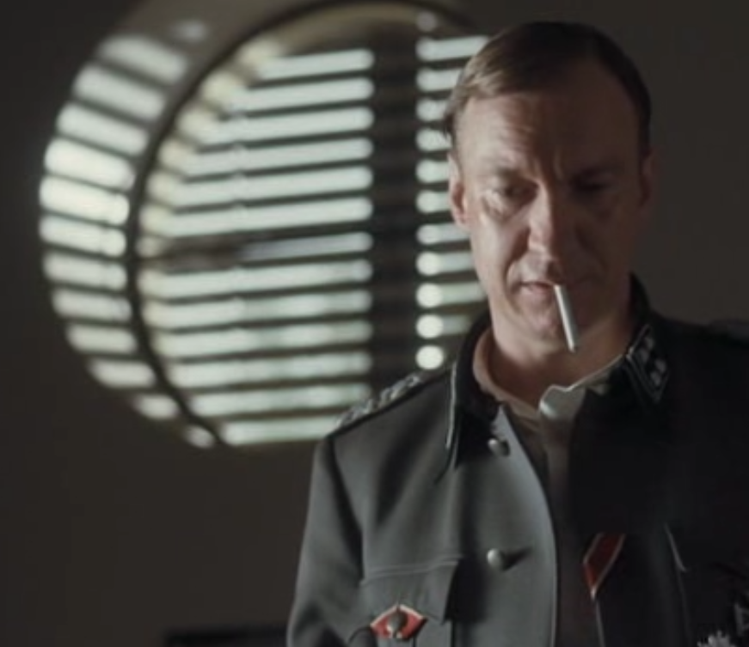
12.Symbolism

Slide 16
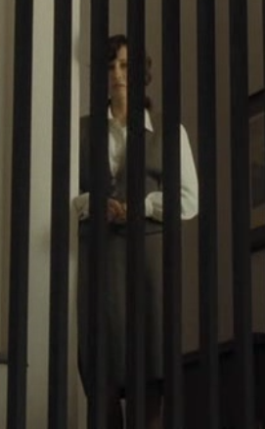
13.Symbolism

Slide 17
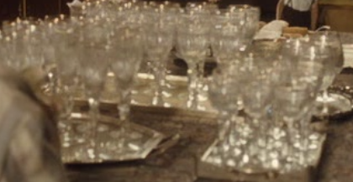
14.Symbolism

Slide 18
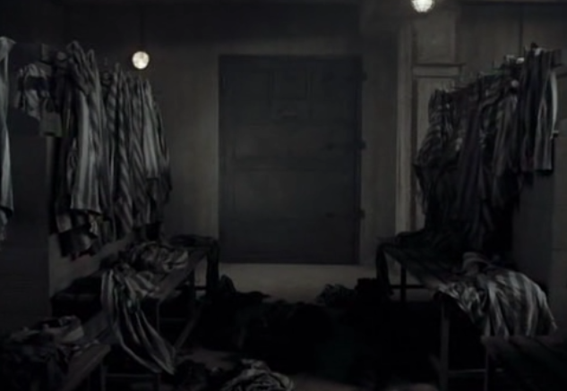
15.Symbolism

Slide 19
16.Symbolism

Slide 20
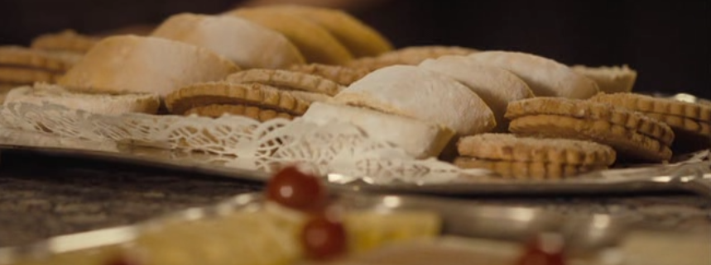
17.Symbolism

Slide 21
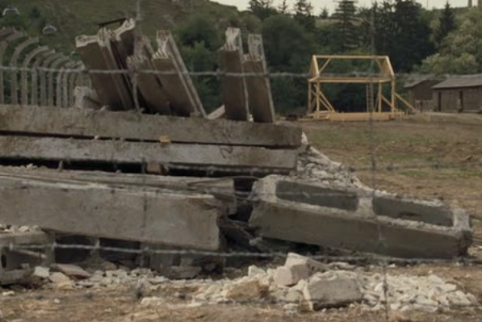
18.Symbolism

